Slide 1


  Welcome Briefing

Slide 2

COURSE START DATE
    September, 15th 2025

Slide 3

TEACHING
Face-to-Face lessons :
  EB (Enseñanzas Básicas – “Theoretical part”)
  EPD (Enseñanzas Prácticas y de Desarrollo – “Practical part”
  100% on campus

Slide 4
CHANGES IN ENROLLED COURSES
ONLINE
  https://www.upo.es/aric/foreign-students/durante-la-estancia/

Slide 5

CHANGES IN ENROLLED COURSES
    Deadline for changes in your inscription : from 17th September to 26th September.
    Traineeship, PG and DD students

Slide 6
CHANGES IN ENROLLED COURSES
17th-26th September
(deadline for changes)
Changes on the registered courses cannot be made after this inscription period. Therefore, contact your home university during this period if you need their approval for the changes made on your previous learning agreement.

Slide 7
CHANGES IN ENROLED COURSES
COURSE ENROLMENT INCIDENTS FORM
Only enrolment incidents provided following this procedure will be taken into account (not for those related to access mistakes, username and password, overlapping, etc.). Any enrolment incident informed by other way will be proceeded.

Slide 8
CHANGES IN ENROLLED COURSES
Academic Offer
https://www1.upo.es/matricula/oferta-academica/

Slide 9
CHANGES IN ENROLLED COURSES
Up to 6 E.C.T.S. credits of courses belonging to different faculties from yours can be registered
_{Double Degree courses}

Slide 10
ACADEMIC COORDINATORS
Academic coordinators are at your disposal to advise you about courses
  https://www.upo.es/aric/estudiantes-upo/tutores-docentes/2025-2026/

Slide 11
SCHEDULE CHECKING
Checking schedule of already enrolled courses
        Personal access
        1. Courses enrolled
        2. Schedule
        3. Blackboard

Slide 12
AULA VIRTUAL
This is a virtual area where you can check the content of each registered course, such as exercises, exams, etc.
You can access by using your username and password via the following path: www.upo.es >> UPO Virtual >> Aula virtual

Slide 13
CERTIFICATE OF ATTENDANCE
IMPORTANT: The Certificate of Attendance will be signed at the end of your study period and will be given only to the student concerned. If you can not bring it by yourself, the departure date will be that of the last exam done.
Maximum departure date:
        FY AND SS:14th July 2026

Slide 14
LEARNING AGREEMENTS
IMPORTANT: You can send it by:
  OLA
  TIKA (pdf)
Before sending your L.A., you must have completed your final course enrolment.
Any deadline has been set so you can send it once it is ready.
Before signing your L.A., we have to check it carrefully so you will not receive it back immediatly. Due to the high amount of messages we receive during this period, the signature will take longer than desired.

Slide 15
INSCRIPTION AS RESIDENT
Hand in the application at the Oficina de Extranjería (Office responsible for foreigners at Plaza de España) or at the relevant Comisaría (Police Station)
Documents needed: passport or national identity card, application form, European Health Insurance Card and a certificate proving you are Erasmus student
The application form is avalaible at: https://administracion.gob.es/pag_Home/Tu-espacio-europeo/derechos-obligaciones/ciudadanos/residencia/obtencion-residencia/inscribirte-residente.html

Slide 16

SEMANA DE BIENVENIDA / Welcome Week

Slide 17
Área de Relaciones Internacionales y Cooperación
Buil.6, ground floor, room 20
Opening times: 9 am – 2 pm
TIKA

Slide 18
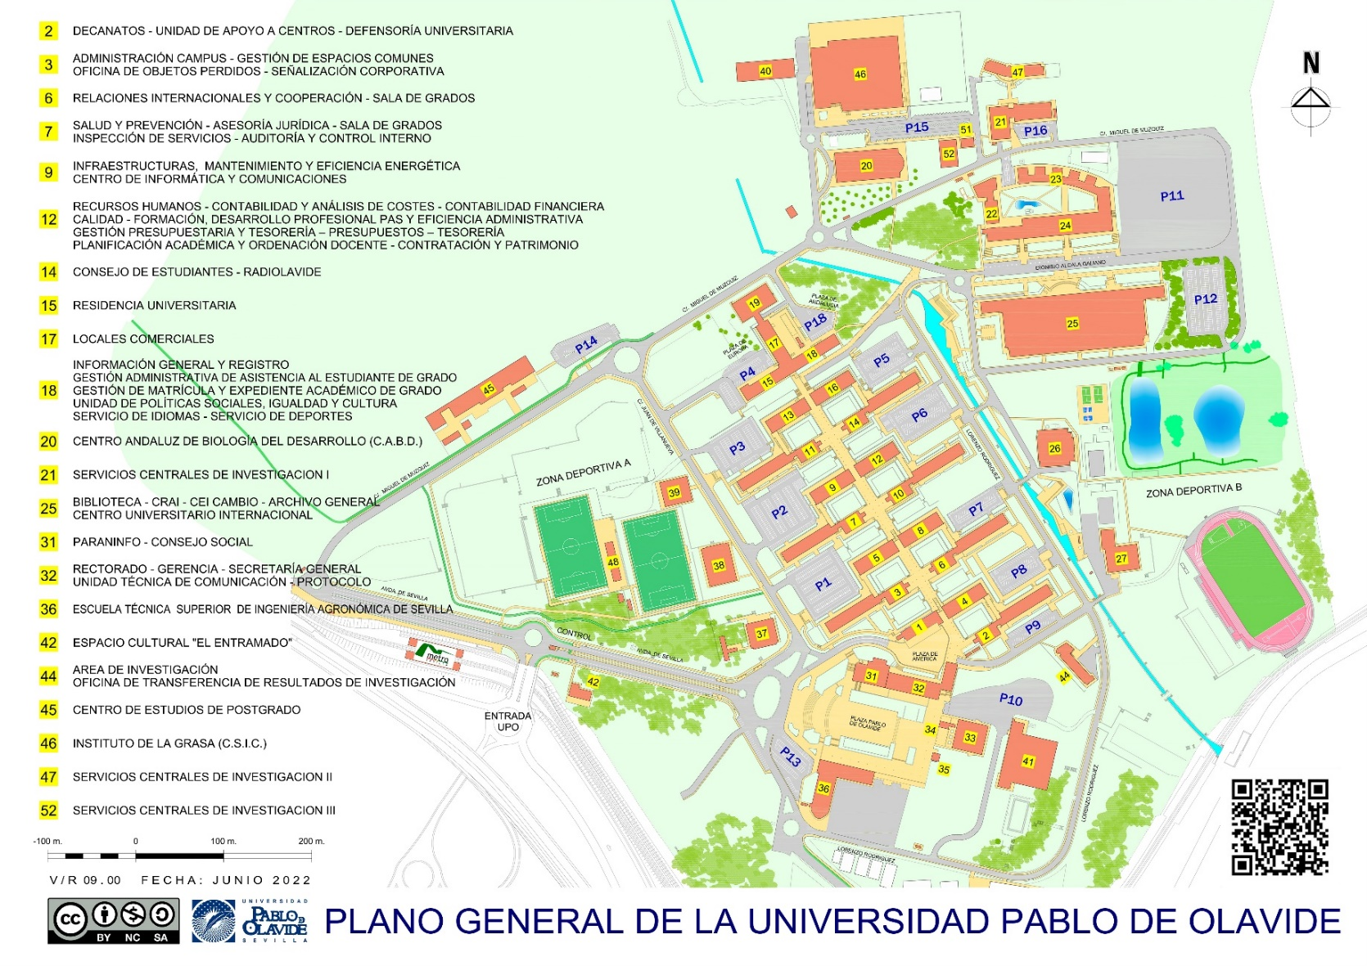

Slide 19


