Slide 1

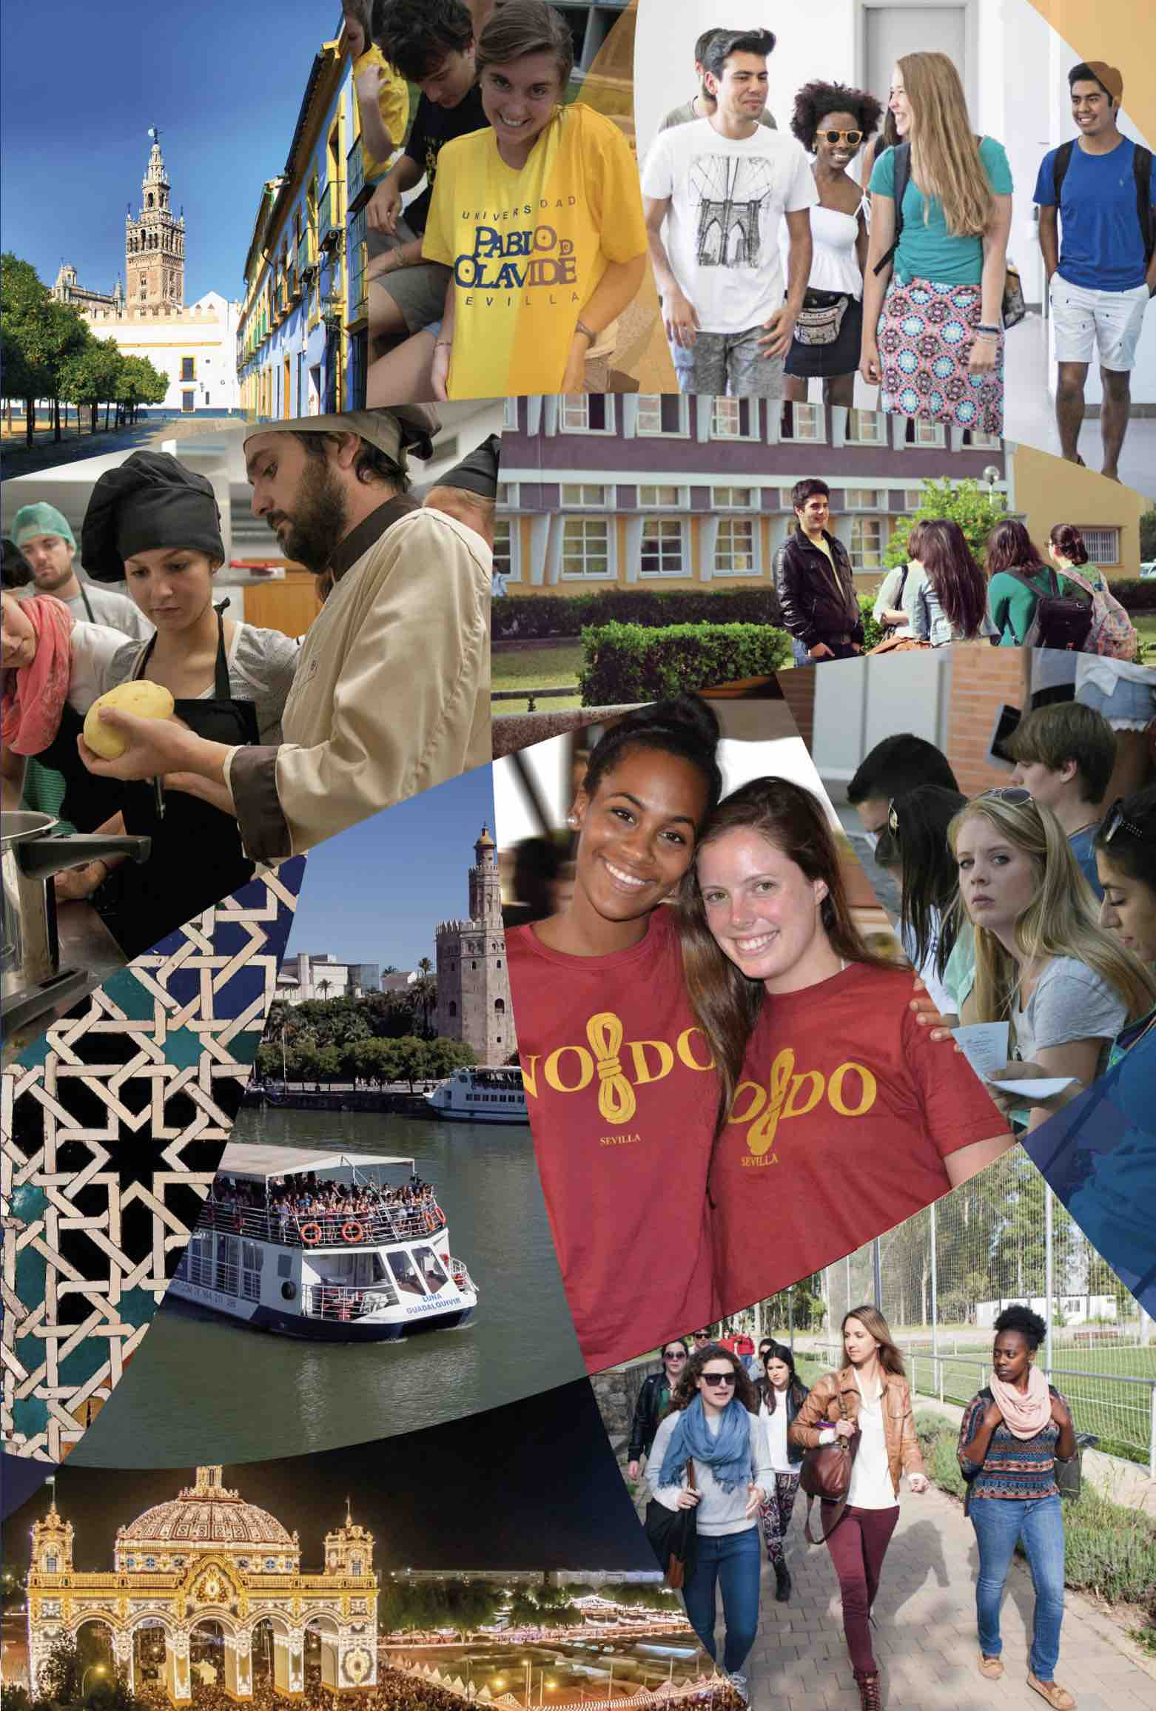
WELCOME!
¡BIENVENIDOS!
The International Center

Slide 2
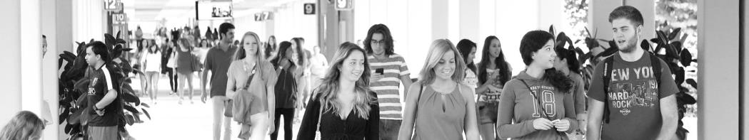





LIFE IN SEVILLE UNDER THE PANDEMIC
                COVID MEASURES AT THE UPO
                CULTURAL ACTIVITIES
                MEETING SPANIARDS
                HOUSING WITH HOST FAMILIES
DAILY LIFE IN SEVILLE DURING THE PANDEMIC

Slide 3

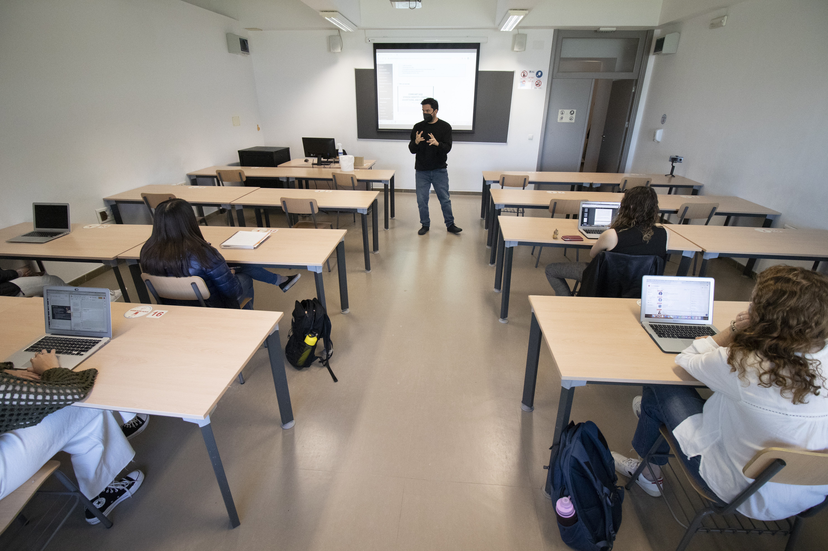

COVID MEASURES AT THE UPO
Classrooms
All of the classrooms are adapted
so that there are 1.5 meters
between each student. Seats are
marked with a “sit here” or with
an X where you shouldn´t sit.
We ask all students to use the hand sanitizer at the entrance of the classroom as they enter.
Disinfectant and paper towels will also be available for students who wish to clean their desk before sitting down.
Windows will be kept open.
You must keep your face mask on at all times.

Slide 4

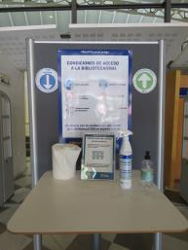
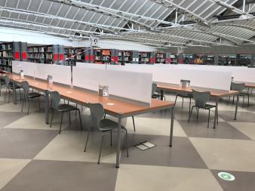
COVID MEASURES AT THE UPO
Library
The library is currently open at
50% capacity from 8:30am – 3:00pm
Monday-Friday.
To use the library, you must reserve
a seat using an app called Affluences.
Books must be reserved online.
You will receive an email telling
you when you can pick them up.

Slide 5

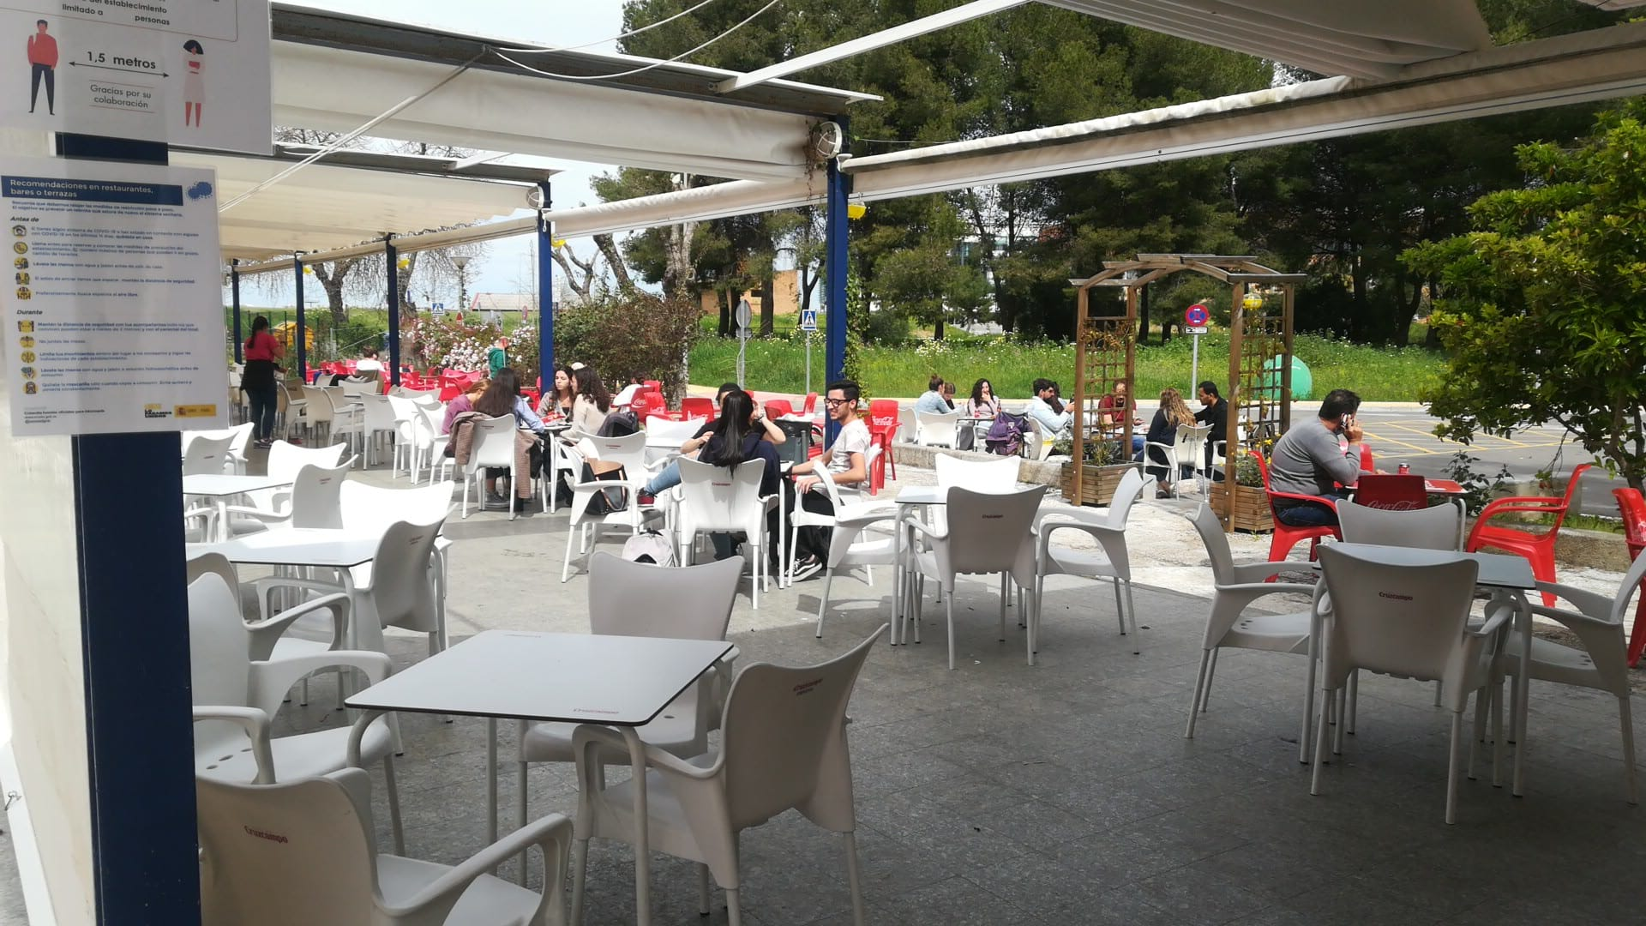
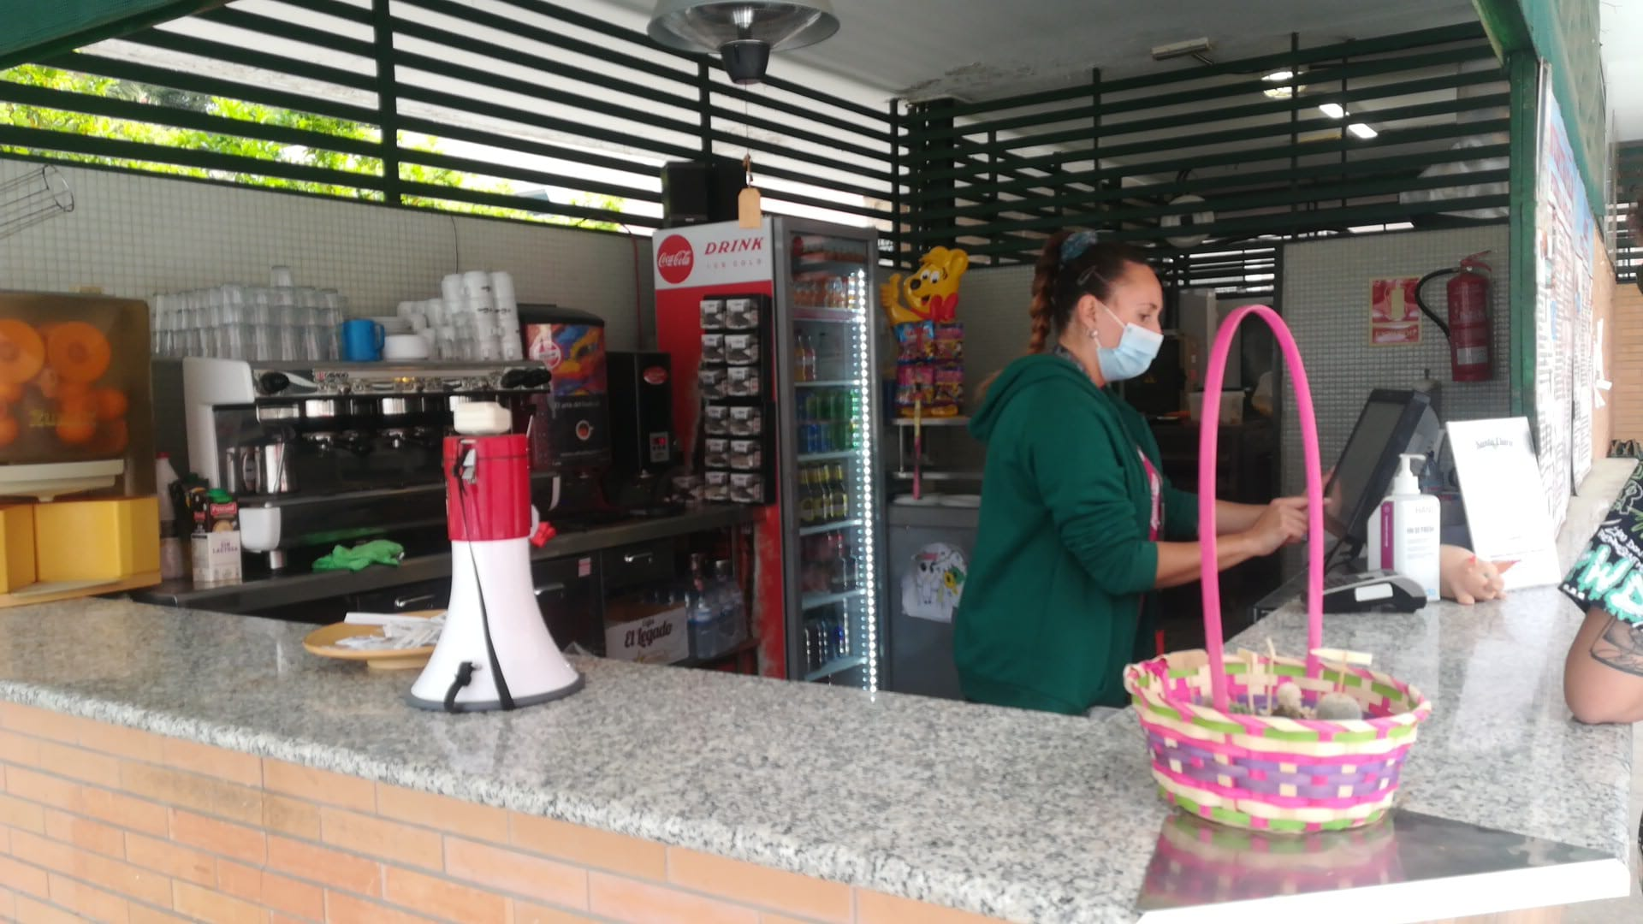
COVID MEASURES AT THE UPO
Cafeterias
The only place that is currently open on campus is a food kiosk. It serves both breakfast and lunch and all seating is outdoors (under an awning for those who prefer shade or when it rains).

Slide 6


COVID MEASURES AT THE UPO
The gym
Currently, the gym is open 9:00am-6:00pm (Mon-Fri)
There are no group classes
The locker rooms are closed (but a restroom is open)
Due to Covid-19 rules, the water fountains on campus are currently turned off.

Slide 7
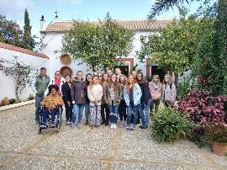
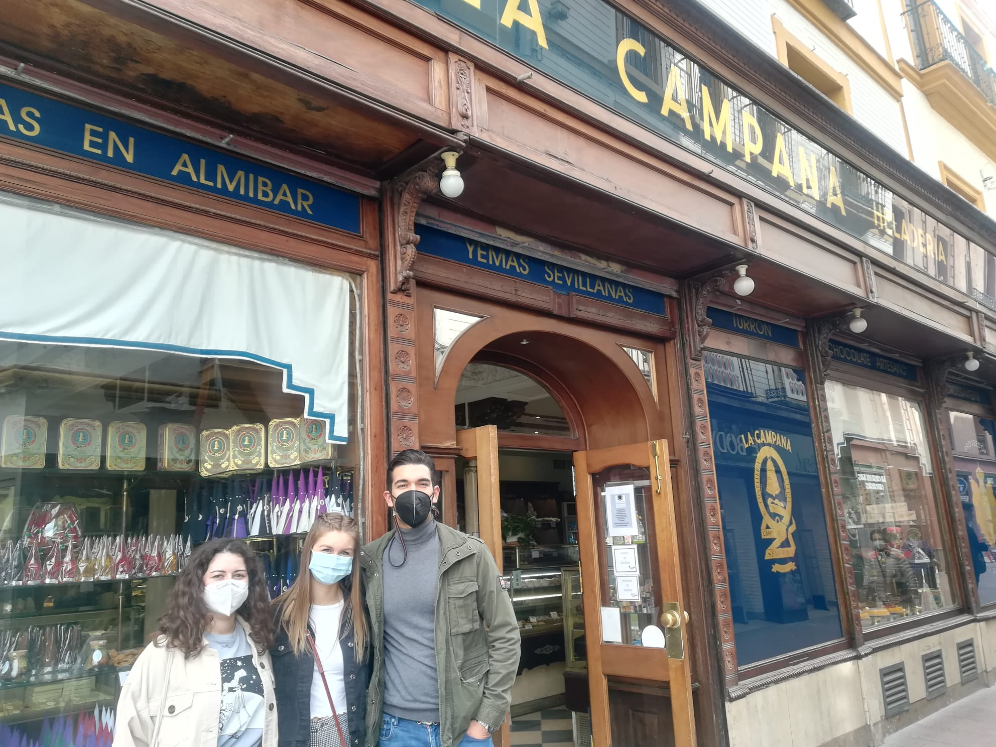

COVID-SAFE ACTIVITIES
Walks through the city center
This is an outdoor activity involving Spanish students, always respecting the Covid-19 measures in place at that time, e.g, number of participants,
movement between towns, etc. We have been able to do two this semester.
Visit to the Basilippo Olive Oil Factory
Visit to the NAO Victoria Ship

Slide 8
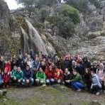
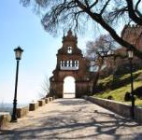
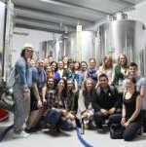
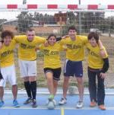
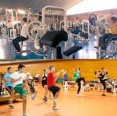
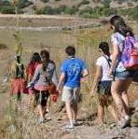

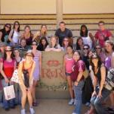
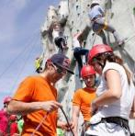
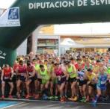
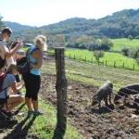
ACTIVITIES FROM PREVIOUS YEARS
Cultural
excursions
Sports activities
Hiking trips

Slide 9
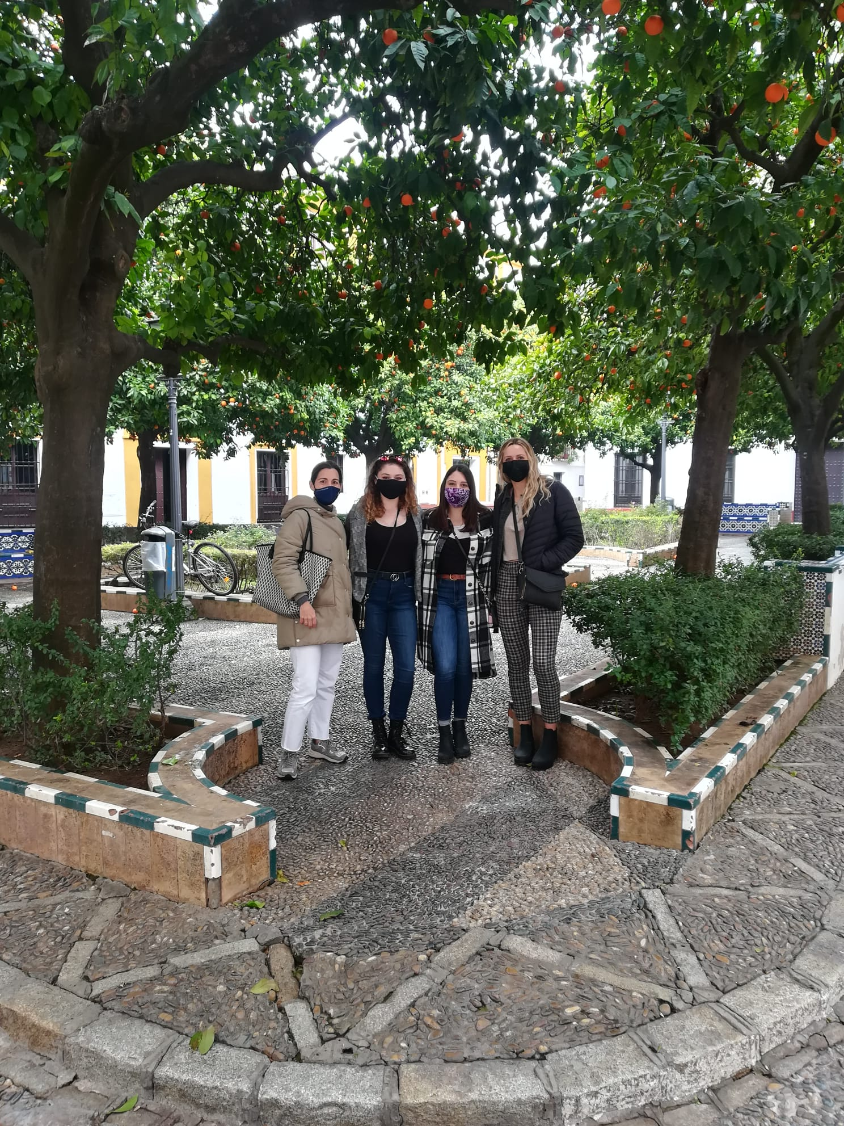
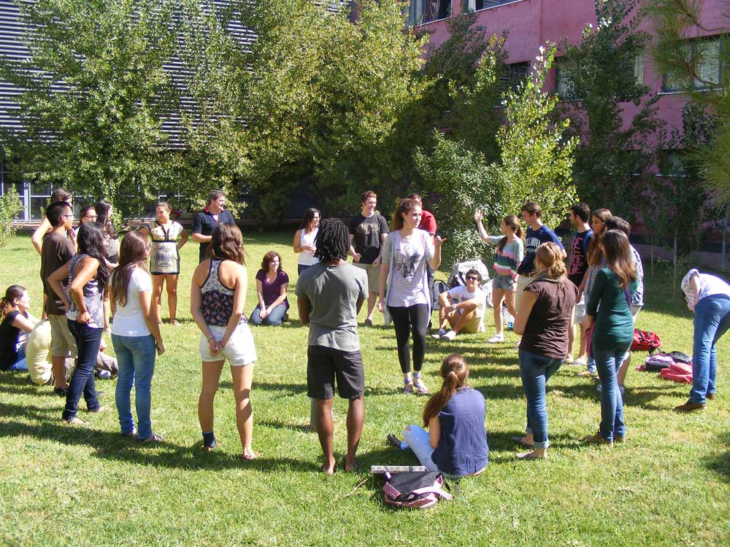
MEETING SPANIARDS
Intercambio Program
Students can sign up for an intercambio - our office matches them up with a Spanish student at the UPO.
It’s a great way to meet Spaniards, practice their Spanish and also get to know better the city and all it has to offer.
We also organize intercambio activities and Spanish/English tables during which our international students can
meet Spanish students.
Volunteering
Students can volunteer one
hour per week at local schools.
Students can also only volunteer to help UPO professors who are teaching courses in English at the UPO.

Slide 10
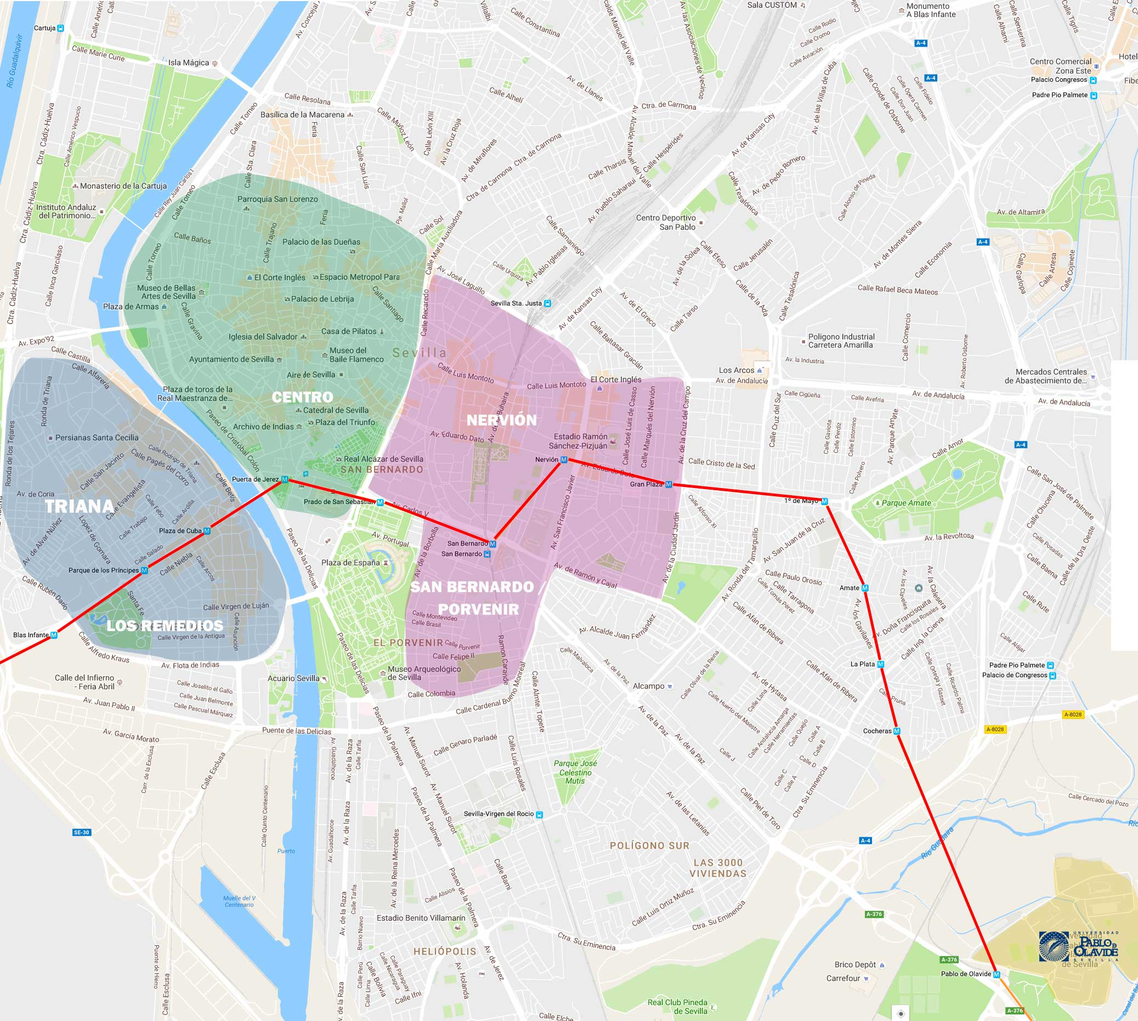
HOUSING WITH HOST FAMILIES
The International center offers lodging with Spanish host families with full board. We feel that this is the best way to learn about Spanish culture and traditions and practice and improve language skills.
All the families have been hosting international students for years and do their best to make the student feel like part of their family.
If a student is a vegetarian, has food or pet allergies or has any special requirements, it is important that we be advised beforehand.
Most of the lodging is in these parts of the city:
- Los Remedios
- Nervión
These two areas are really nice, close to the city center and with a metro station really close that connects easily with the campus.

Slide 11

HOUSING WITH HOST FAMILIES
Covid-19 measures
Due to the pandemic, all students will be placed in single rooms with private bathrooms. Only one student per host family.
Students will need to follow the instructions currently in place regarding Covid-19 legislation which may be consulted here: https://www.upo.es/intl/covid-19-news/?lang=en
If a student becomes ill with Covid-19 during their stay with the host family, the student must:
  Isolate in their room and only use the bathroom designated for their use.
  Wear a face mask if they must enter or cross a common area and spend as little time in the common area as possible.
  Take all their meals in their room.
  Remain in isolation for 10 days (the last 3 days must be symptom-free).

Slide 12
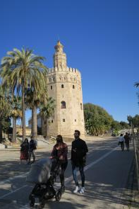
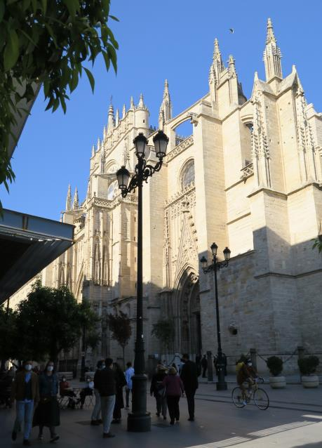
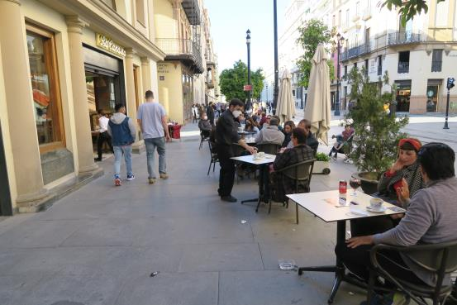
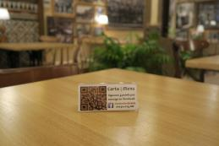
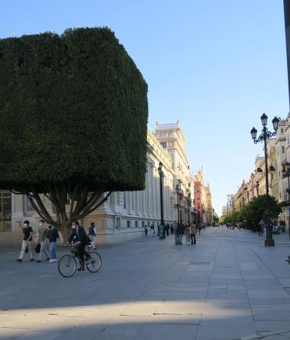
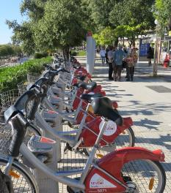
DAILY LIFE IN SEVILLE
Notes:
As you can see, everyone wears masks unless they are eating or drinking at café or restaurant.
Most menus are now not on paper but online and accessed via a QR code.
Most people eat outside but the inside of all restaraunts is also open, however you will always see Windows and doors wide open.

Slide 13

LIFE IN SEVILLE DURING THE PANDEMIC
¿PREGUNTAS?
QUESTIONS?
MDGOMVAL@ACU.UPO.ES
Notes:
Any questions? Either specific or general questions you may have?

