Slide 2
SEMESTER-LONG PROGRAMS
HISTORY & PARTNER UNIVERSTIES/PROVIDERS
THE HISPANIC STUDIES PROGRAM
SPANISH LANGUAGE AND CULTURE PROGRAM
UNIVERSITY INTEGRATION PROGRAM
SEVILLE

Slide 3
HISTORY
First program (Hispanic Studies Program) began in the fall of 2001.

Slide 4
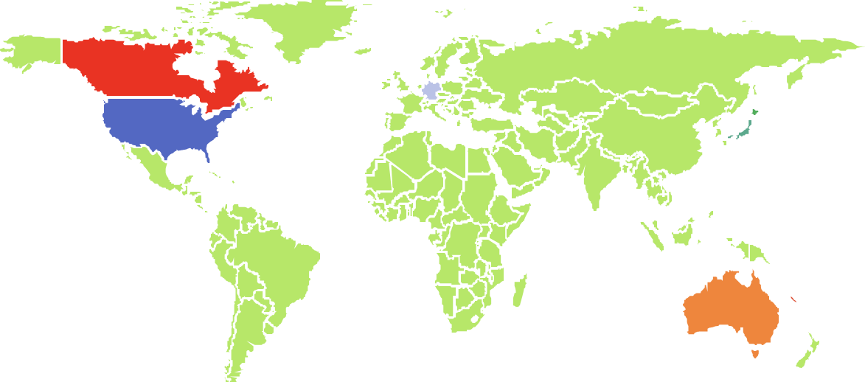
PARTNER UNIVERSTIES/PROVIDERS
THE UNITED STATES
Appalachian State
University
California State University
Monterey Bay
Johnson & Wales
Juniata College
New Mexico State University
CANADA
Dalhousie University
Mount Royal University
University of Calgary
University of the Fraser Valley
Western University
North Central College
Academic Programs International (API)
Academic Studies Abroad (ASA)
Active Learning Abroad (ALA)
ADELANTE
Nortern Arizona University
Presbyterian College
Texas Christian University
GERMANY
Global Education and Career Development Abroad (GlobalEd)
University of New England
The Center for Cross-Culturas Studies (CCCS)
Council on International Educational
Exchange (CIEE)
Cultural Experiences Abroad (CEA)
Washington & Jefferson College
Duale Hochschule
Baden-Württemberg
JAPAN
AUSTRALIA
Chukyo University
International Studies Abroad (ISA)
Mundolengua
University of the
Sunshine Coast
Spanish Institute for Global Education (SIGE)
World Endeavors
MALAYSIA
University of Malaya

Slide 5
THE HISPANIC
STUDIES PROGRAM
Over 40 courses in both English and in Spanish.
Highlights:
Science courses with a lab component
Spanish language classes at 6 different levels
Communication, Psychology and business courses among the most popular
Tapas class - most popular course in Spanish
History of Art and Cinema
Biology / Chemistry/Nutrition
Business
Communication
Economics
History
Dates:
- Spring ’22: January 24 – May 17, 2022
- Fall ‘22: September 12 – December 20, 2022
Prices:
- Spring ‘22: 2,315 euros
- Fall ‘22: 2,365 euros
(up to 15 U.S. or 30 ECTS credits
Literature
Political Science
Psychology
Sociology
Spanish Culture / Anthropology
Spanish Language

Slide 6
The University Integration Program
Classes with Spanish students
Highlights:
Students with advanced Spanish language skills are able to choose from a wide array of classses
Business majors are able to take business courses in English with Spanish students
Biotechnology
Business
Economics
Environmental Sciences
Humanities
Dates:
- Spring ’22: January 31 – June 10, 2022 - Fall ’22: mid Sept– January
Prices: - Spring ‘22: 1,670 euros
- Fall ‘22: 1,705 euros
(up to 15 U.S. or 30 ECTS credits)
Human Nutrition & Dietetics
Labor Relations
Law
Political Science
Social Education & Social Work
Sociology
Sports Science

Slide 7
Designed as an immersion program for students with one or two semesters of university level Spanish.
Highlights:
Includes an intensive Spanish language course
All the courses are in Spanish
The mix of courses improves students’ language skills in all areas
Spanish Language
& Culture
Program
Spanish language (4x/week)
Spanish Culture
Dates: Sept. 12 – Dec. 9 (under
90 days)
Price: 2,075 € (15 U.S./30 ECTS credits)
Only offered during the fall
Spanish Reading and Composition
Spanish Conversation

Slide 8
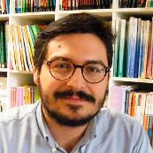
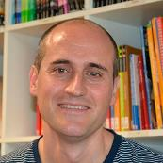
What’s included
Orientation Session
Joanna Wandycz-Mejías
Center Director
Mentxu Zalla Ansola
Center Office Manager
Welcome and Farewell Receptions
Cultural/Social Activities
Language Exchange Partner & Volunteering at Local Schools
Rubén Díaz López
Coordinator of Professors
Jorge Pascual Díaz
Center Communications Officer
Manager
Lola Gómez Valpuesta
Housing Coordinator
Official University Transcript
Office hours: Monday-Thursday 8am-6pm
Friday 8am-3pm
intl@upo.es
Notes:
By the way, the prices mentioned previously are for students who enrol directly with us.
If students come to us through one of our wonderful providers, they will receive 24 hour

Slide 9
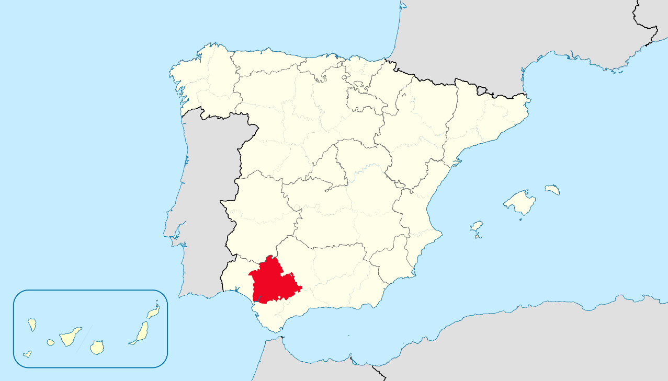
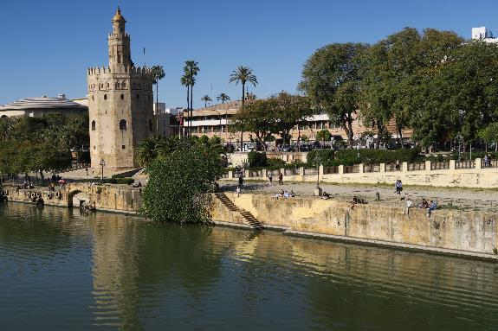
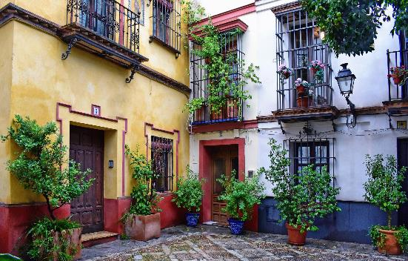
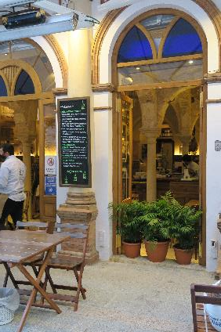
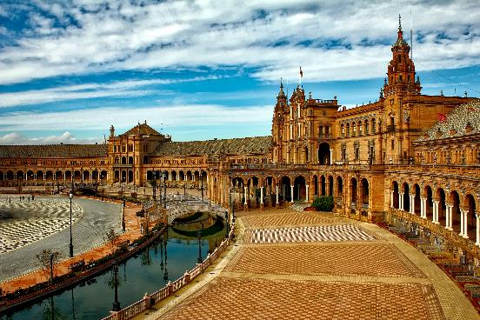
Location
SEVILLE

