Slide 1
WELCOME!
¡BIENVENIDOS!
The International Center

Slide 2
SHORT-TERM PROGRAMS
JANUARY SPANISH INTENSIVE PROGRAM
IN-PERSON SUMMER SESSION 1
IN-PERSON SUMMER SESSION 2
SEPTEMBER SPANISH INTENSIVE PROGRAM
COVID MEASURES FOR IN-PERSON CLASSES
SEVILLE

Slide 3
JANUARY SPANISH INTENSIVE PROGRAM
Pre-elementary Spanish
Pre-intermediate Spanish I
Pre-intermediate Spanish II
Pre-advanced Spanish I
Dates: January 10 – January 21, 2022 Application deadline: December 1, 2021
Academic credits: 2 U.S (4 ECTS) credits
30 contact hours
Price: 370 euros
318€ partner price
Notes:
EDUC 350E will be in English and there is interest from Spanish students so we might have an international group

Slide 4
IN-PERSON SUMMER SESSION 1
SPAN 102 Elementary Spanish
SPAN 201 Intermediate I Spanish
SPAN 241 Intermediate II Spanish
AND
SPAN 331E Contemporary Spanish Culture and Society OR
SPAN 331 Cultura y Sociedad Española Contemporánea
Dates: May 16 – June 10, 2022 (4 weeks) Application deadline: April 22, 2022
Academic credits: 6 U.S (12 ECTS) credits
Price: 1,140 euros
950€ partner price
Notes:
All these courses are in English except for the Spanish literature course

Slide 5
IN-PERSON SUMMER SESSION 2
SPAN 241 Intermediate II Spanish
SPAN 311 Advanced I Spanish
Included: Weekly cultural activities
Official University transcript
Dates: June 13 – July 1, 2022 (3 weeks) Application deadline: May 9, 2022
Academic credits: 3 U.S (6 ECTS) credits
Price: 570 euros
475€ partner price
Notes:
All these courses are in English except for the Spanish literature course

Slide 6
SEPTEMBER SPANISH INTENSIVE PROGRAM
Pre-elementary Spanish
Pre-intermediate Spanish I
Pre-intermediate Spanish II
Pre-advanced Spanish I
Dates: 5 – 9 September, 2022
Application deadline: July 11, 2022
Academic credits: 1 U.S (2 ECTS) credits
Price: 202 euros
175€ partner price
Notes:
All these courses are in English except for the Spanish literature course

Slide 7
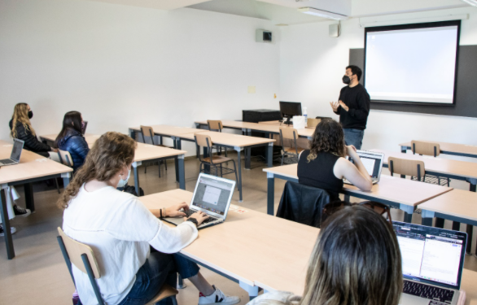
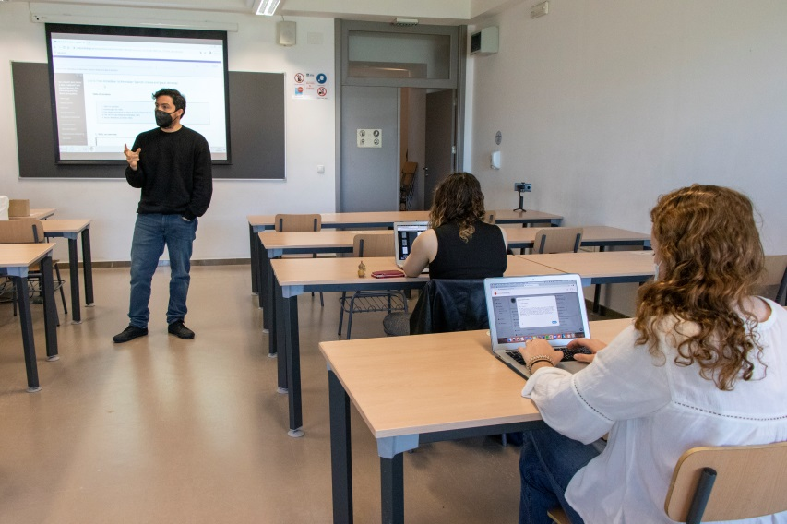
COVID MEASURES FOR IN-PERSON CLASSES
Students must keep their face mask on at all times when inside classrooms and buildings.
All social distancing measures in the classrooms have been lifted and classrooms are back to 100% capacity.
There is hand sanitizer available at the entrance of the classroom.
Disinfectant and paper towels are also available for students who wish to clean their desk before sitting down.
Windows and doors are kept open to facilitate ventilation.
Notes:
All these courses are in English except for the Spanish literature course

Slide 8
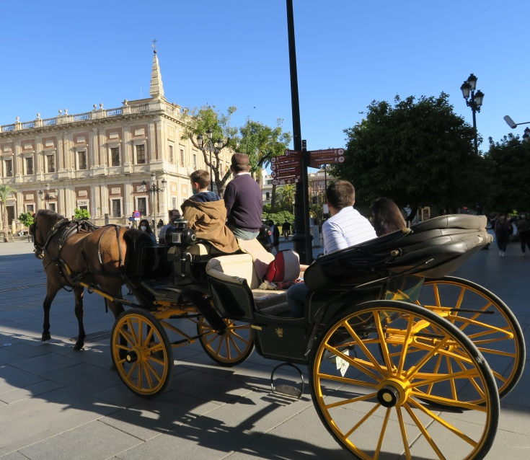
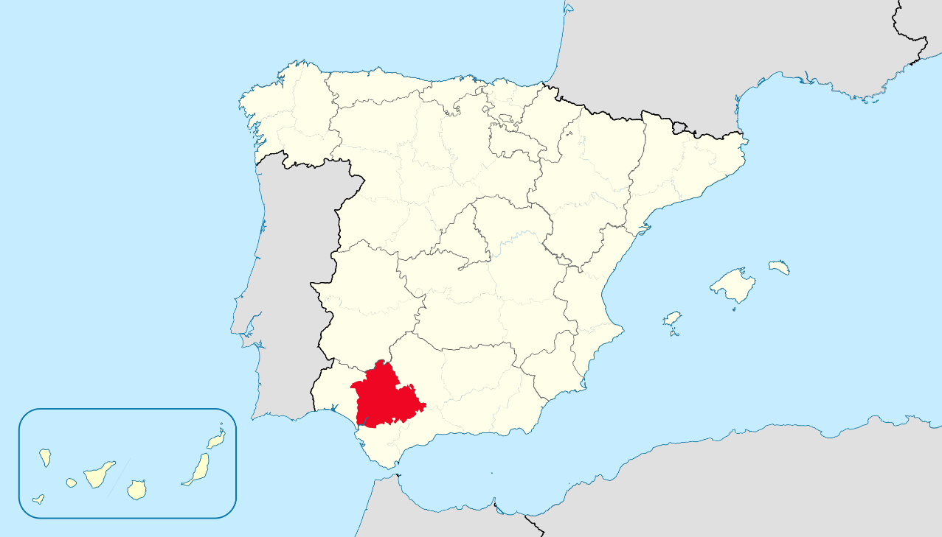
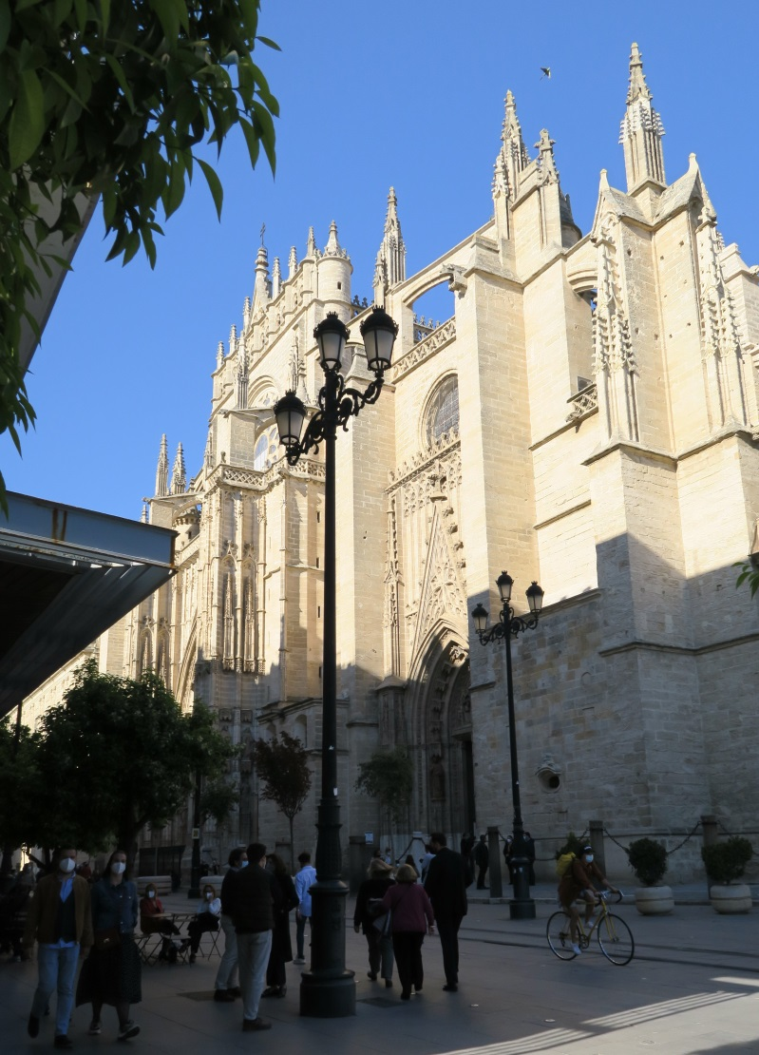
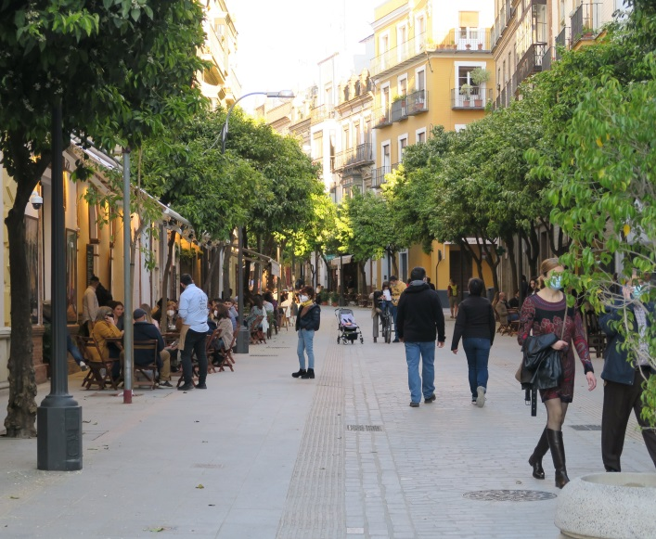
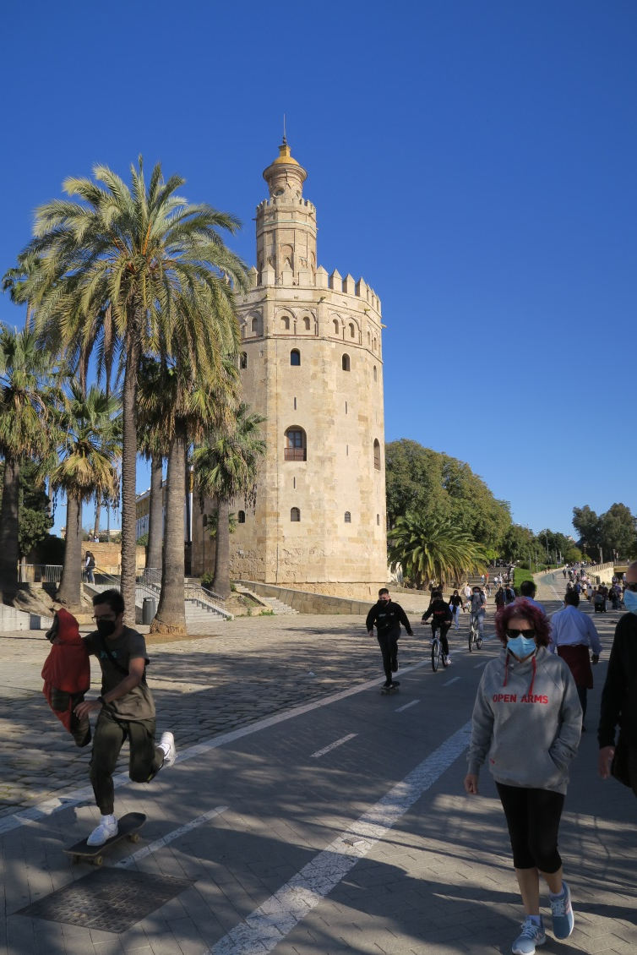
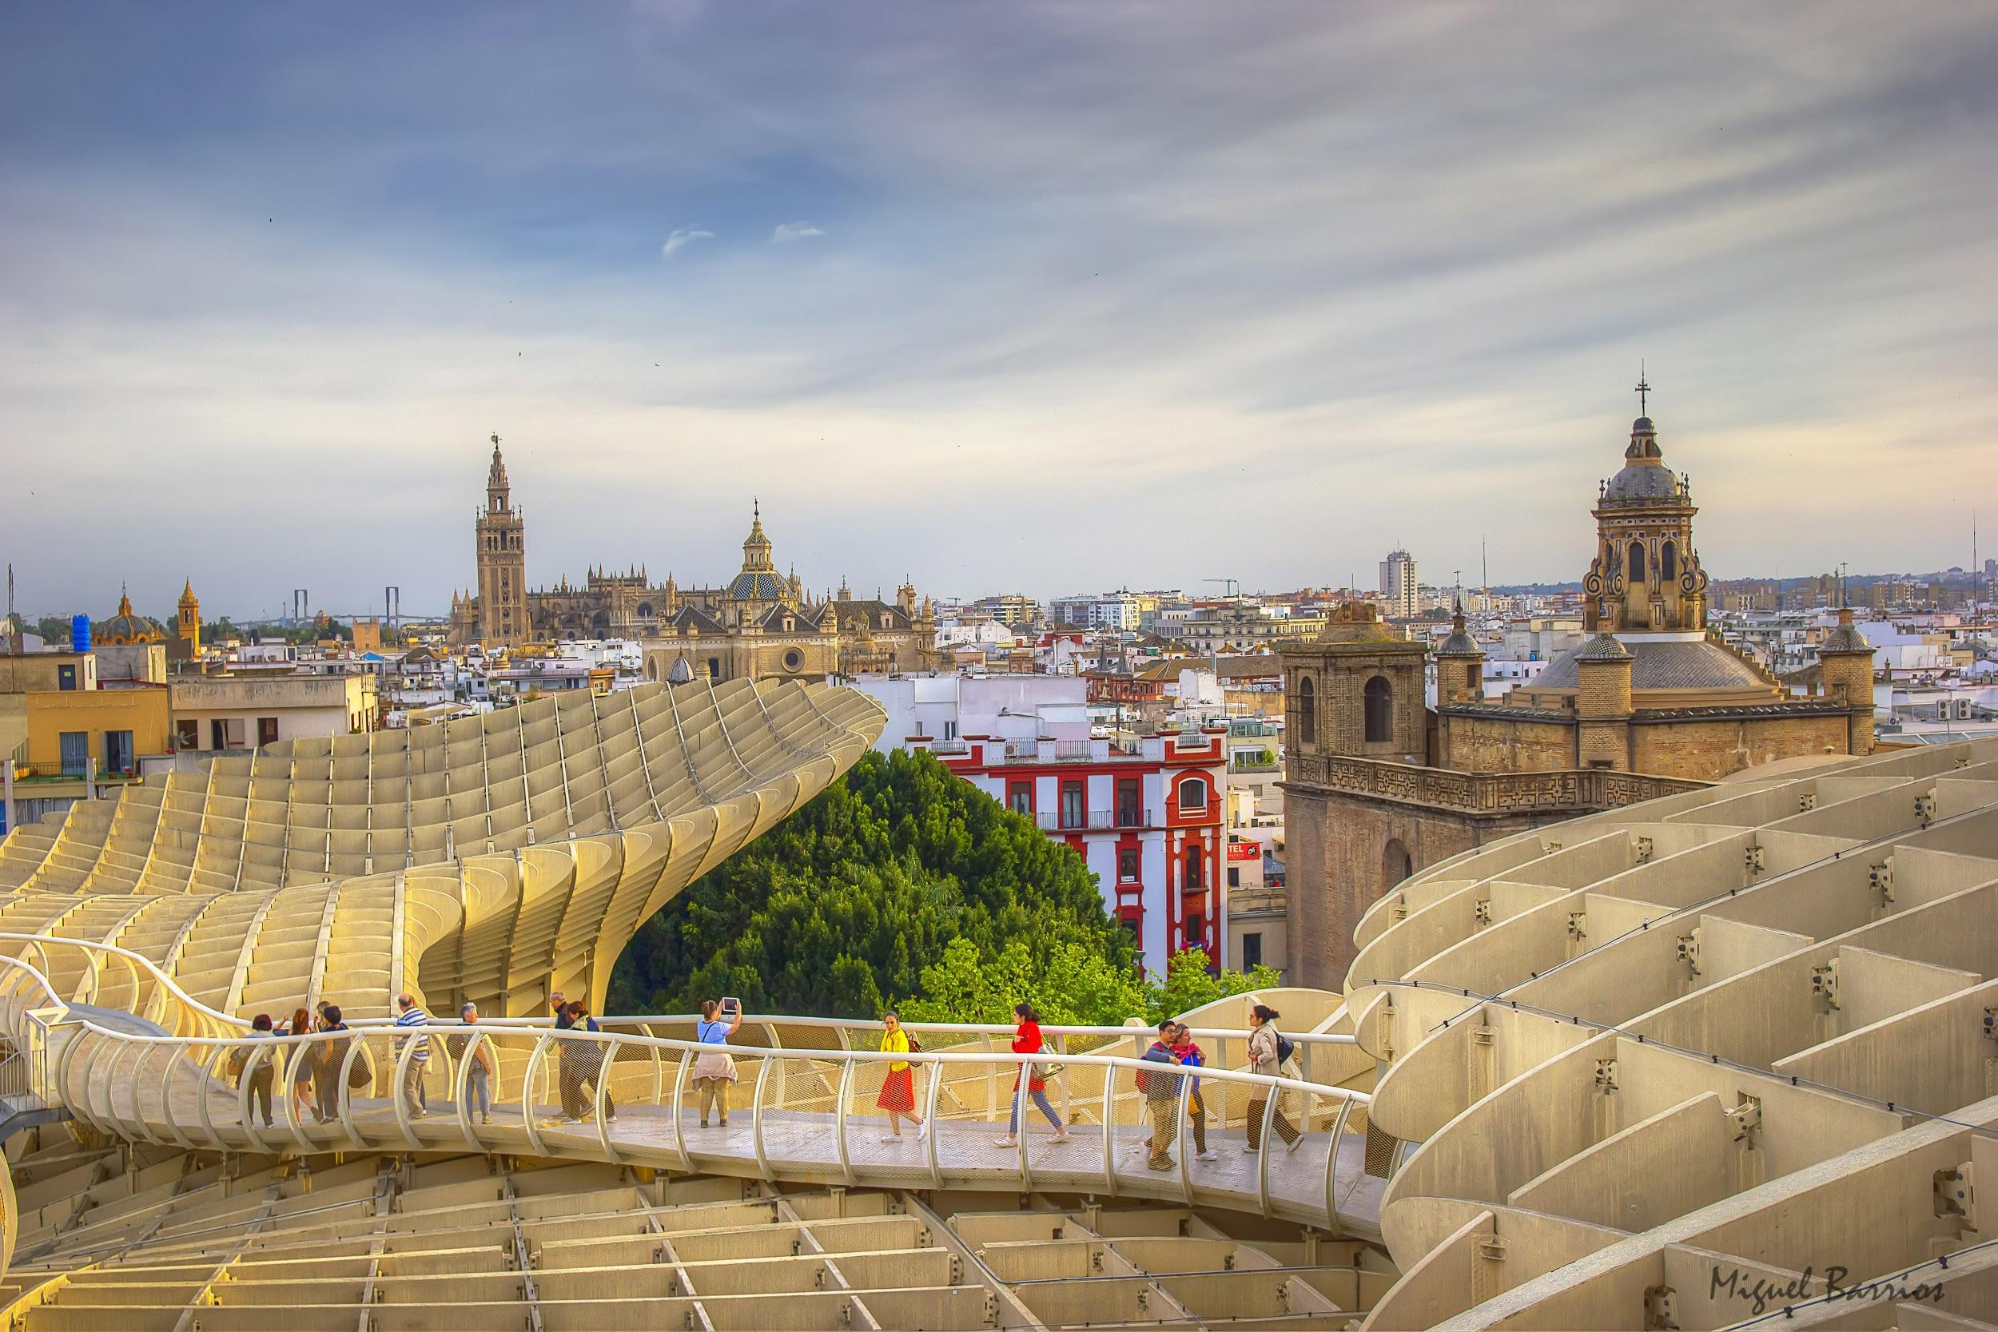
Location
SEVILLE

